Slide 1
Expense Tracker Application
Somuadina Egbulam | Full stack Java web app

Slide 2
What is the Expense Tracker?
Personal expense tracking system
Add and manage expenses
Analyze spending habits
Interactive dashboard
Persistent data storage

Slide 3
Features Implemented
✅Add expenses with category, amount, date, and description
✅ Spending breakdown by category
✅ Monthly spending trend analysis
✅ Total expenses and expense count
✅ Highest and lowest spending categories
✅ Delete expense entries
✅ CSV-based persistent storage
✅ Auto-seeded with sample expenses

Slide 4
Project Architecture
Single-process Java web application
Uses Java built-in HTTP server
No Spring Boot
No Maven or Gradle
Lightweight deployment

Slide 5
Data Storage
In-memory ArrayList
CSV file persistence
Auto-save on updates
Auto-load on startup
No database required

Slide 6
Data Visualization
📊 Doughnut chart → Spending by category
📈 Bar chart → Monthly spending trend
💰 Expense statistics

Slide 7
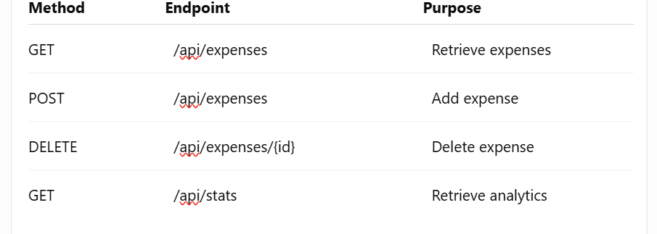
REST API Endpoints
Backend API Design

Slide 8
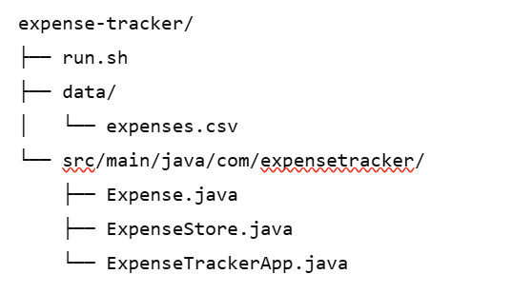
Project Structure

Slide 9
Running the Application:
How To Run
Install Java JDK 25+
Run the application
Open browser at localhost:8080
Compile Java source files

Slide 10
Testing & Verification
Seeded with 15 sample expenses
Tested adding expenses
Tested deleting expenses
Verified chart rendering
Verified CSV persistence

Slide 11
Challenges and Solution
No database allowed
Real-time UI updates
Maintaining persistence

Slide 12
Design Approach
3-Class Architecture Design
Expense.java → Data model
ExpenseStore.java → Storage & business logic
ExpenseTrackerApp.java → Server, API, and frontend

Slide 13
Conclusion
✅ Lightweight Java web app
✅ Clean architecture
✅ Interactive analytics dashboard
✅ Persistent expense tracking

Slide 14

THANK YOU

